Slide 1

TES Teacher Recruitment Index
MARCH 2016
Making sense of the teacher recruitment landscape for school leaders and department heads

Slide 2

The TES Teacher Recruitment Index is based
on four years of data. It tracks trends in the changing ability of schools in England to recruit teachers. It is updated with 5000 school interviews three times a year.
We hope the data in this report help to stimulate fruitful discussion among your team.

Slide 3
Spring 2016 Headlines
There is growing recognition of teacher shortages
TES data shows recruitment was slightly easier in autumn 2015 than 2014
But in all subjects except art & design and design technology, it is harder to recruit now than it was in 2012
Teachers in England don’t feel valued – 17.5 per cent said they were “certain” to quit teaching within three years
Talk of teacher shortages is self-perpetuating – 31.1 per cent of teachers said talk about a “recruitment crisis” made them feel more likely to leave the profession
And yet teachers can break the cycle…two thirds of teachers say they would feel more optimistic if they were “treated as partners in the debate, rather than objects of discussion”
So how can we make sure we’re all involved in the debate and finding solutions together?
Notes:
Recruitment pressure may have eased off overall in the 12 months to autumn 2015 but there is no doubt that we are facing a real shortage in teaching talent across England. The number of school leaders facing “serious shortages” trebled in just four months to January. Nine out of ten school leaders are finding it difficult to recruit.
TES data show it’s particularly telling for specific regions like the East of England and the North West and for subjects like science and maths.
There are many factors at play here. It’s increasingly clear that we now have a global marketplace for teachers and that this is going to put an even greater strain on our ability to appoint locally in the years to come. It is estimated that the growing international schools sector will require an additional 200,000 teachers in the next five years and the UK is one of the primary talent pools.
Related to this, morale is low and talk of the recruitment crisis is taking its toll. But we have been here before as a profession. Teachers surveyed indicate they are up for the challenge of solving these issues. Teachers want to be involved in the debate.

Slide 4
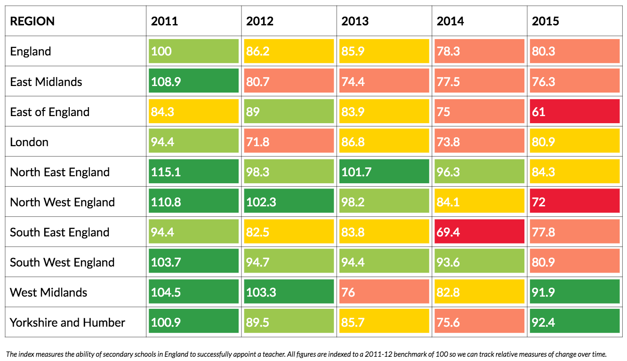
It is important to understand that different schools are facing different recruitment issues. The TES Index provides a regional breakdown showing how the situation varies across regions and years.
How do we feel we are doing against the average for our region?
Notes:
English regions where teacher recruitment is currently the most challenging:
East of England (1)
North West of England (2)
East Midlands (3)
South East England (4)

Slide 5
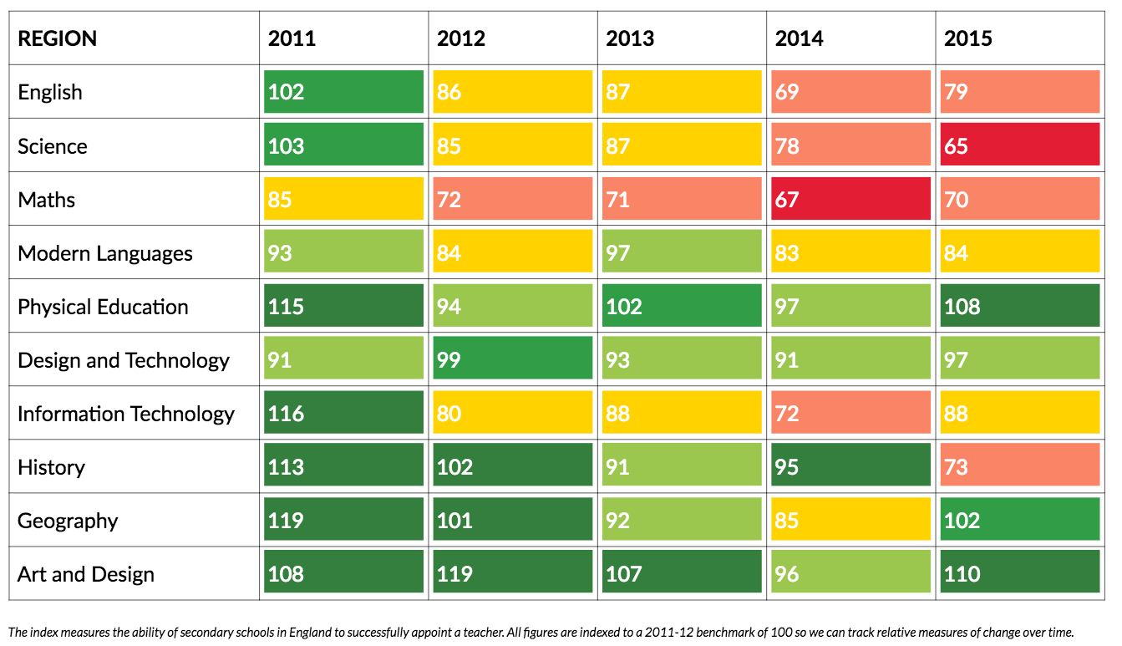
Similarly, different departments are facing different issues, with recruitment difficulties more likely in some subject disciplines than others. The TES Index shows these variations across subjects and years.
How do we feel our departments are faring against the average for each subject discipline?
Notes:
Subject disciplines where it is currently hardest to recruit:
Science (1)
Maths (2)
History (3)
English (4)

Slide 6
Through our work with thousands of schools and school leaders,
we are aware of a wide range of school management responses
being advocated or tested:
  Embracing flexible working practices
  Better understanding of recent graduates
  Better management of recruitment budgets
  Don’t let teachers leave in the first place
  The value of alumni networks
  More drastic action!
Notes:
Schools are leading the way in finding solutions to the current situation. Here are some of the ways we have heard about that school leaders are being creative about filling vacant positions.
Policy Exchange found that one in four teachers leaving the profession were women aged 30-39 - half do not return to teaching when they rejoin the workforce. The ASCL recently proposed that schools do more to embrace flexible working.
Research by the Ashridge Business School found that today’s graduates expect management roles within 3 years - school leaders are recognising the importance of setting out a clear career path for new teachers
TES Recruitment recently launched a range of subscription services to help schools get better value and more from recruitment budgets
Schools have an opportunity to help teachers move into new roles in different schools, where they may be happier, rather than letting them leave the profession. This can be mutually beneficial for all schools.
Staying in touch with teacher alumni, especially if they leave for caring responsibilities, provides an excellent database of prospective returners in the future
We have even heard of schools building housing for staff on school land and creatively researching and hiring teachers from abroad.

Slide 7

For more information on the TES Teacher Recruitment Index or to discuss ways to get value from your school recruitment budget, please contact:
jobs@tesglobal.com
+44 (0)20 3194 3050
Or visit: www.tes.com/recruit

